Slide 1
Hurricane Harvey – Track Analysis
Data Analytics & Visualization 2020

Slide 2
Project Information
Project Team (Group 6):
Reza Abasaltian, Vincent Adams, Jeremy Jones, & Rob Pascarella
Project Scope:
As a group we have decided to gather data from offshore weather stations and platforms to perform an analysis of weather attributes as they correlate to the intensity of Hurricane Harvey.
Weather attributes analyzed:
Wind Speed; as our measure of intensity
Water Salinity
Air Pressure
Water Temperature
Air Temperature

Slide 3
Questions
What weather attributes contributed the most, if any, to the intensity of Hurricane Harvey?
Did water temperature affect intensity of the hurricane the most?
Did air temperature affect the intensity of the hurricane the most?
Did air pressure affect the intensity of the hurricane the most?
Did water salinity affect the intensity of the hurricane the most?
How will this problem be attacked?
We plan to answer these questions by utilizing various statistical analyses. Graphically, we will represent our data in scatter plots to show correlations as well as box plots to show our outliers in within each data set.

Slide 4
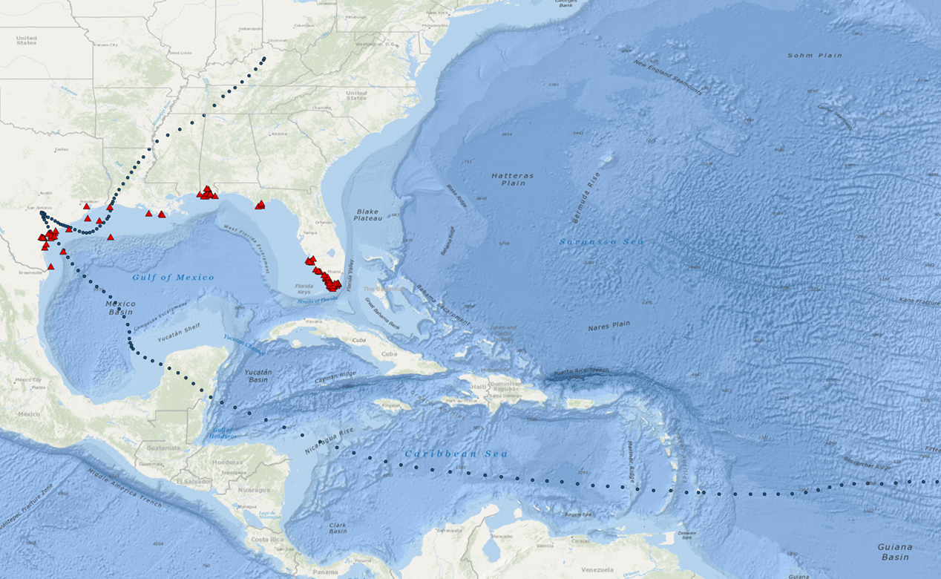
Project Data Sources
Data Retrieval
.csv data:
Gulf of Mexico Coastal Ocean Observing System
http://data.gcoos.org/waf.php
National Hurricane Center
https://www.nhc.noaa.gov/data/tcr/AL092017_Harvey.pdf
-Utilized data, created a csv for Harvey track
API:
GMaps
https://cloud.google.com/maps-platform/

Slide 5
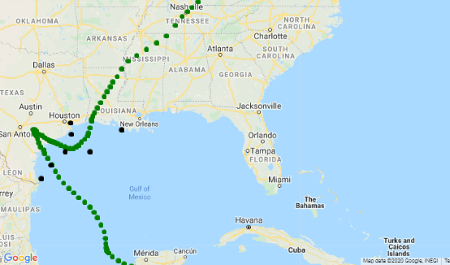
Project Data Point Locations
Selected Data Points:
A = 42043
B = 42044
C = 42047
D = 8764314
E = 8770613
F = TABS-X
G = 42019
E
A
D
G
C
F
B

Slide 6
Data Cleanup

Slide 7
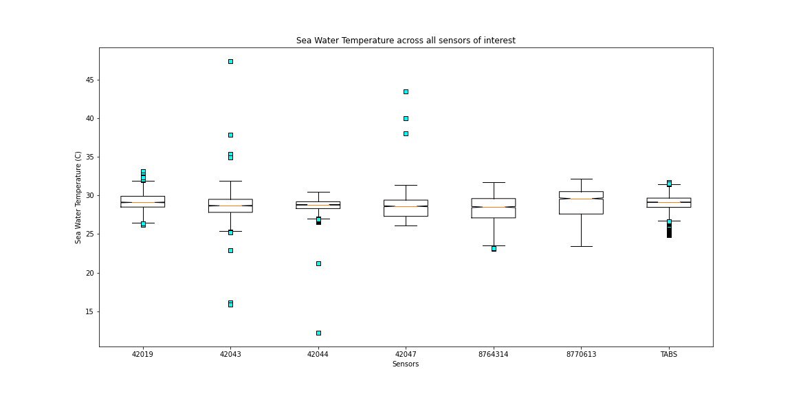
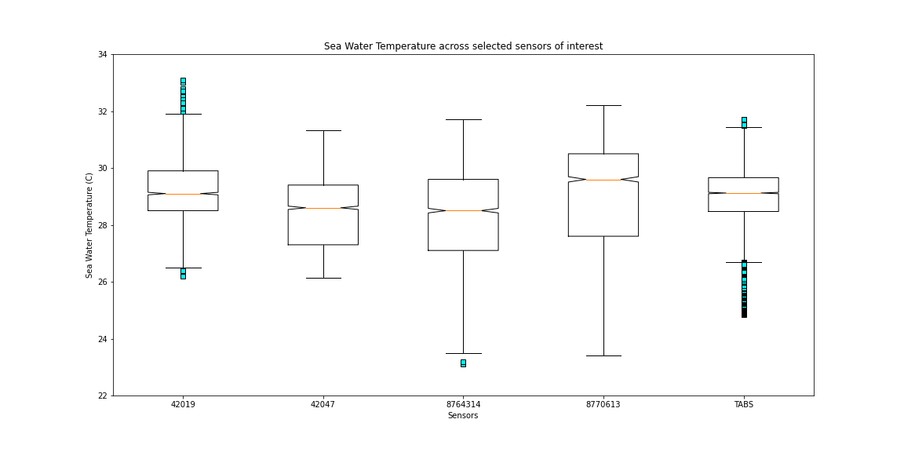
Water Temperature

Slide 8
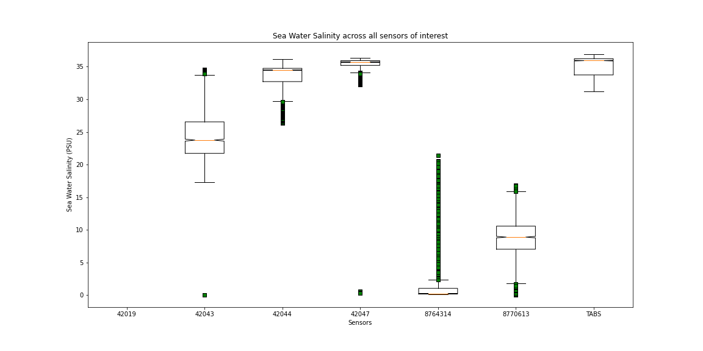
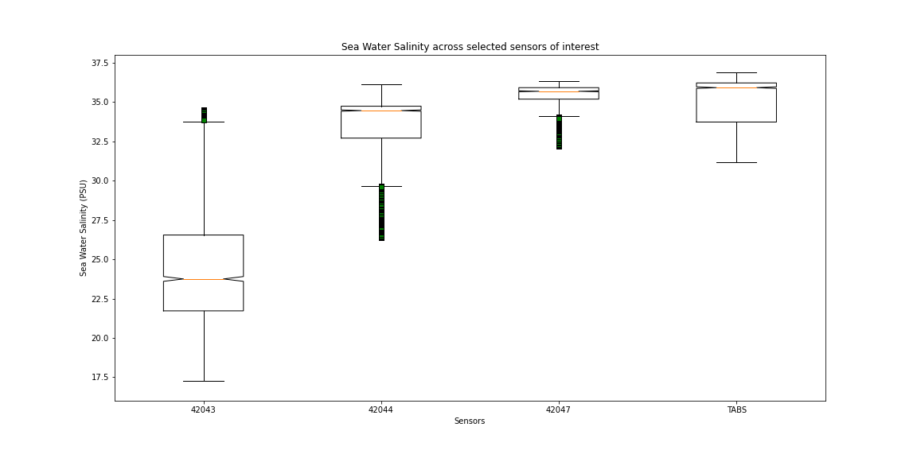
Water Salinity

Slide 9
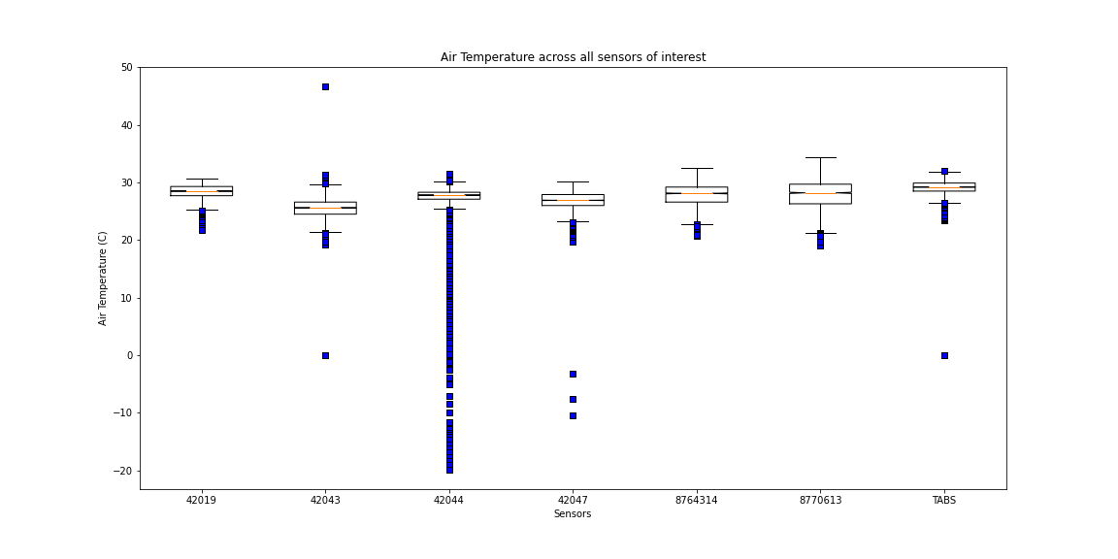
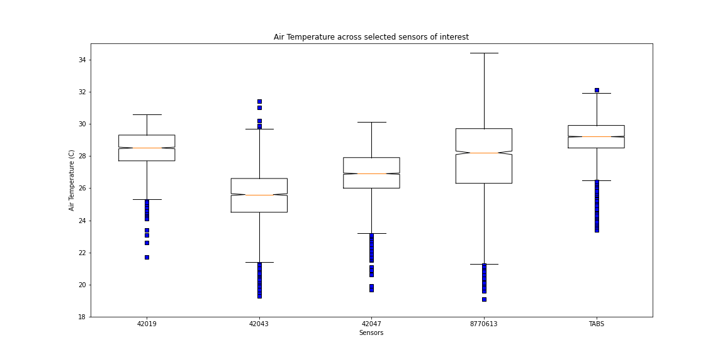
Air Temperature

Slide 10
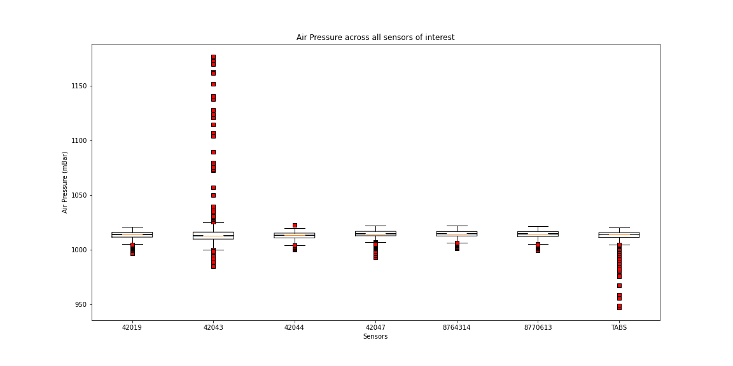
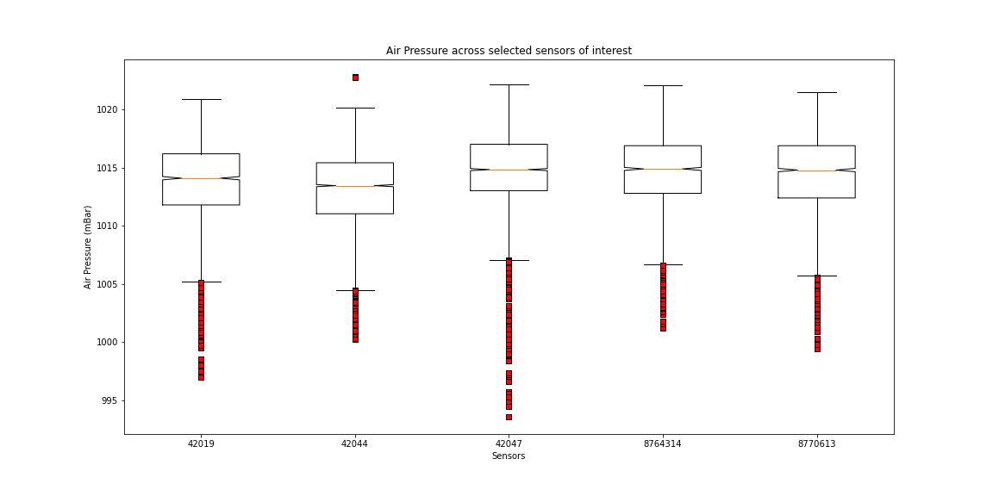
Air Pressure

Slide 11
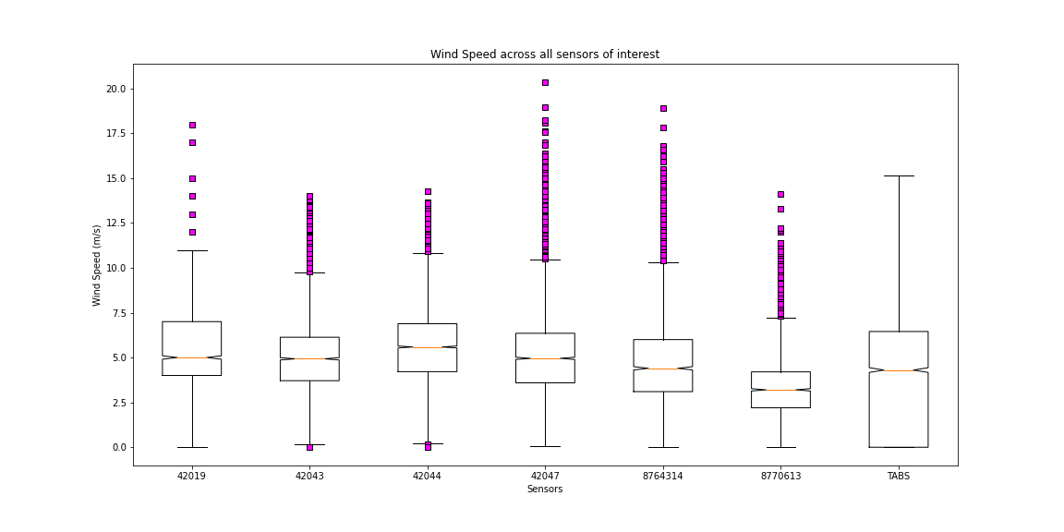
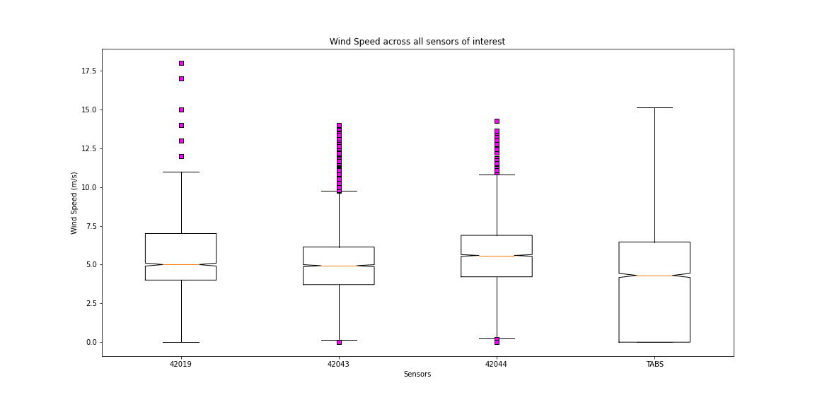
Wind Speed

Slide 12
Limitations
Limited data points within the direct path of the storm.
Incomplete data sets on some of the original targeted data points.
Erroneous data on some the data sets during the actual Hurricane.

Slide 13
Conclusions

Slide 14
Findings

Slide 15

Questions

